Slide 1
SALES ANALYSIS presentation OF PARCH AND POSEY COMPANY
BY:
OYEDUN SAMUEL

Slide 2
agenda
Introduction
Data Collection
Data Cleaning
Data Exploration
Insights and Recommendations

Slide 3

INTRODUCTION

Slide 4
INTRODUCTION
Parch and Posey specializes in producing and distributing three types of paper: Standard, Gloss, and Poster Paper. The company has 50 Sales Representatives, strategically located across four major U.S. regions: Northwest, Southeast, West, and Midwest.
The purpose of this analysis is to gain valuable insights from the Company’s data and improve its sales performance.

Slide 5

DATA COLLECTION

Slide 6

DATA COLLECTION
The data was sourced from the Parch and Posey database, which consists of five tables:
Accounts:
Contains details about customer accounts, including account ID, account name, primary contact person, account location, and sales representative ID.
Order:
Includes information on account ID, order quantity, total amount spent on each paper type, and the date of the transaction.

Slide 7
DATA COLLECTION
Region:
Lists region IDs and region names.
Sales Representatives:
Contains sales representatives' names, IDs, and their associated region IDs.
Web Events:
Captures the channel through which customers learned about the company.

Slide 8

DATA CLEANING

Slide 9
DATA CLEANING
The dataset was loaded into PostgreSQL for cleaning and analysis.
The data cleaning process involves checking for duplicate or null values, correcting inconsistencies, and formatting the data for analysis.

Slide 10
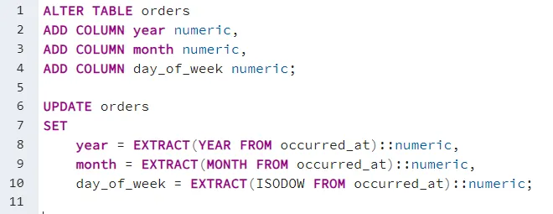
DATA CLEANING
Creating new columns for year, month and date from the occurred_at column in the orders table:

Slide 11
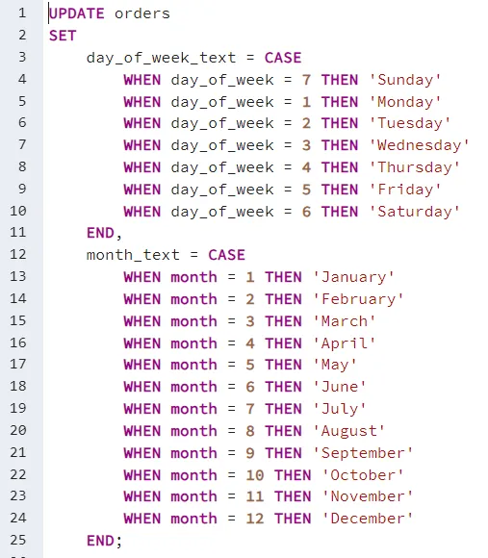
DATA CLEANING

Slide 12
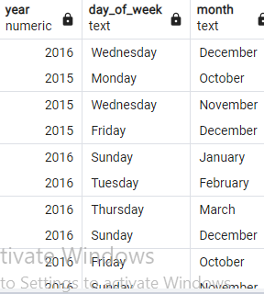
DATA CLEANING
Result of the above codes

Slide 13

DATA exploration

Slide 14
Data exploration
Once the data was cleaned and standardized, I conducted exploratory data analysis to examine the dataset and address key business questions.

Slide 15
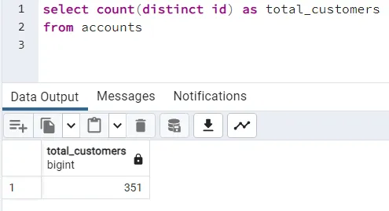
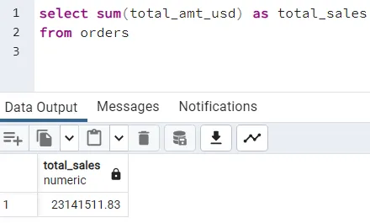
Data exploration
How many customers does parch and posey have?
How much revenue has parch and posey made?

Slide 16
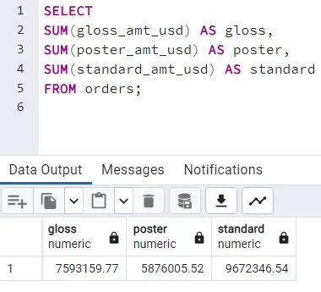
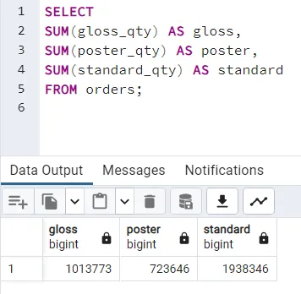
Data exploration
3. What is the revenue for each product?
4. What is the quantity of total orders per product?

Slide 17
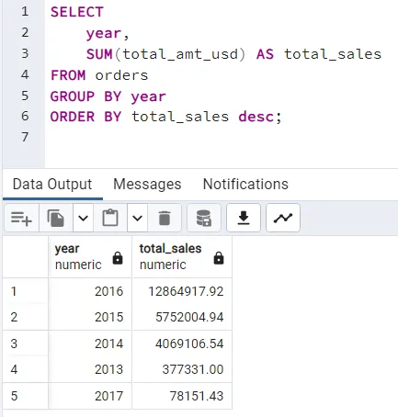
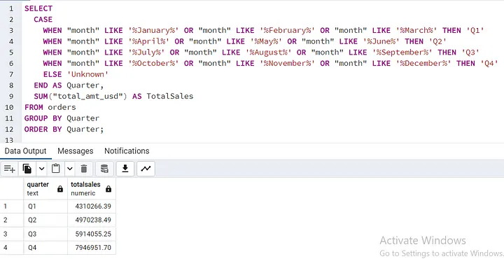
Data exploration
5. How much has Parch and Posey made between 2013–2017?
6. What is the quantity of total orders per product?

Slide 18
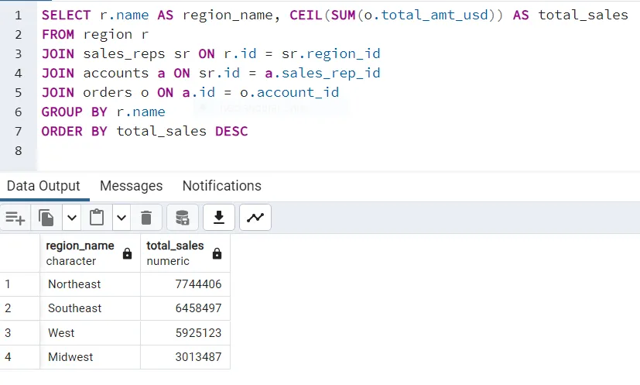
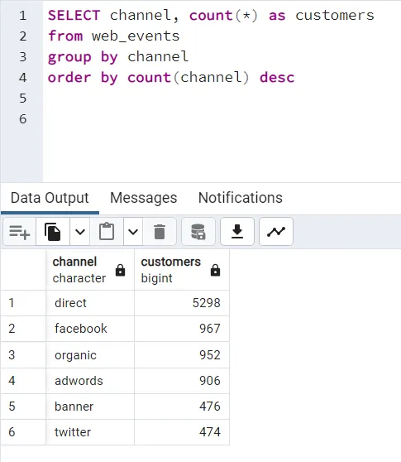
Data exploration
7. What is the most profitable region for parch and posey?
8. what channel of recruiting customers yields the most results?

Slide 19

Insights and Recommendations

Slide 20
Insights and Recommendations
Standard Paper stands out as our best-selling product, accounting for 41.8% of total revenue and 52.7% of all orders. To further capitalize on this success, I recommend enhancing our marketing efforts for Standard Paper.
The company saw significant growth beginning in 2013, culminating in a peak revenue of $12.8 million in 2016. While revenue dropped to $78,000 in 2017, it's crucial to note that we only have data from January of that year. As a result, it’s recommended to continue with the marketing strategies and sales policies that brought success in 2016.

Slide 21
Insights and Recommendations
Among the regions, the Northwest region proves to be the highest revenue generator, while the Midwest region lags. To boost sales in the Midwest region, we should intensify our marketing efforts there.
Direct customer outreach is a highly effective strategy, responsible for 58% of our customer acquisition. This approach has been the most successful in bringing new clients to Parch and Posey.
These insights and recommendations can guide us in capitalizing on our strengths while addressing areas that require attention.

Slide 22
Thank you
Oyedun Samuel
09078159834
tittitobiloluwa2014@gmail.com

